Slide 1

First Steps Analysis Document
Jump the Queue V1.4

Slide 2


Statement of Purpose
Customers value their time as much as business owners do, and existing ticket dispensers do not help caring about them. Currently, customers need to physically go to the establishment, take a number and wait for a while. Not only is this system inefficient, as customers have to book an unreasonable amount of time only to get to the shop assistant, but also a sales barrier, as many customers get discouraged and walk away, or do not even visit the shop.
Capgemini proposes an outstanding application to manage your queue. This service will contribute to a relaxed visit through your shop by prescribing customers when to approach your desk.
This application helps you improve the customer satisfaction as it eliminates the need to stand waiting, reduces the actual and perceived wait time and improves your business image.
Capgemini only delivers user-centric and scalable applications which are easy to use and solve your problems at the same time.
Project Introduction

Slide 3
Objectives & Requirements
The objectives of the project are:
Reduce the actual and perceived waiting time.
Improve the user experience by easing the access to the queue.
Simplicity and scalability.
Requirements
Support a registration process.
Support a terms & conditions acceptance process.
Show the expected time the customer will have to wait and an indication of the number of people before him.
Ensure that only one ticket number is assigned to a user.

Slide 4
Glossary of Terms
Queue
Waiting time
Desk where customers are attended. The queue is opened every working day by the queue owner or closed by either the owner or an automated process.
Estimated period the customer will need to wait to be called in to the counter.
Non-attended customer
Attention time
Customer that has joined the queue and has got a ticket number and is not attended yet. The customer currently being attended is also considered a non-attended one as the service is not completed yet (no end-time is registered).
Time spent attending to a customer. It will be calculated as the period between the moment the customer starts to be served and the moment the next customer is called.
Ticket number
Individual code that is assigned to a customer when he or she joins the queue. This code will be used to call the customer in.

Slide 5
Actors
Visitor
Jump the Queue client that wants to join the queue.
Owner
Owner of a business and client of Jump the Queue. The owner will manage the operation of the queue.

Slide 6


User Story Map
USER STORIES
USER STORIES
USER STORIES
Register and log in
Join and consult the queue
Operate the queue
EPICS
Show the login screen
See the home screen
Call next customer
Register in the queue system
Request to join
Start the queue
Read Terms & Conditions
Calculate the waiting time
Stop the queue
Log out
Show status of the queue

Slide 7

Step 1 Register and log in
At this step, the user registers in the application for the first time or logs in.
To perform this step, Jump the queue must support the following:
Accept terms & conditions
Filling out of personal data
Verification of human identity (No robot)
© 2017 Capgemini. All rights reserved.

Slide 8
User Story 1
Show the login screen
I need
to access the login screen
So that
I can access the service provided by the shop
Acceptance Criteria:
The user can choose to register or log in.
The user can enter his or her username and password.
The username must be an email.
If the user requests to log in, the system checks if the user has entered a valid username and password.
If the user has requested to log in and the username or password are missing or are not valid, the system informs the user.
The user can request a password reminder email be sent to his or her registered email account.
Visitor
Owner
Priority:
Size:
Dependency:
© 2017 Capgemini. All rights reserved.

Slide 9
User Story 2
Register in the queue system
I want
to fill in the registration form
So that
I can get registered in the queue system
Acceptance Criteria:
The user can enter the following mandatory information:
Username, which must be a valid email account
Password
Name
Telephone
By default the commercial notifications must be deactivated.
The user can refuse to receive commercial notifications.
The user can accept the terms and conditions.
The user can click the “No robot” captcha.
Once the terms & conditions are accepted and the “No robot” captcha is checked, the “Accept” button is enabled.
Visitor
Priority:
Size:
Dependency:
© 2017 Capgemini. All rights reserved.

Slide 10
User Story 3
Read Terms & Conditions
I need
to read the terms and conditions of the queue
So that
I can complete my registration
Acceptance Criteria:
The user can read the terms and conditions statement of the queue.
Visitor
Priority:
Size:
Dependency:
© 2017 Capgemini. All rights reserved.

Slide 11
User Story 4
Log out
I need
to log out of the system
So that
I can log in as another user
Acceptance Criteria:
At any moment, the logged in users can log out of the queue system (“Logout” button) and their ticket number must persist in the system.
Upon logout request, the user is sent to the login screen.
Visitor
Priority:
Size:
Dependency:
© 2017 Capgemini. All rights reserved.

Slide 12
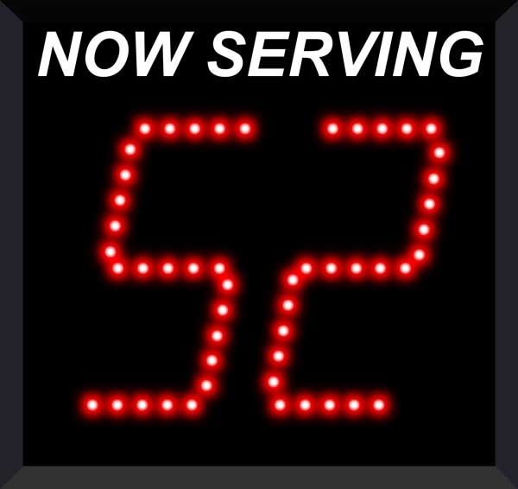
Step 2 Join and consult the Queue
This step contains all functions to request a ticket and consult the status of the user in the queue.
Jump the queue must support the following:
Show customers their position in the queue
Show the estimated waiting time to be served
© 2017 Capgemini. All rights reserved.

Slide 13
User Story 5
See the home screen
I want
to see the home screen of the queue
So that
I can decide to join it
Visitor
Acceptance Criteria:
The user can see the current ticket number being served in the queue.
The user can request to join the queue (“Join” button).
The user can request to go back to the login screen (“Logout” button).
Priority:
Size:
Dependency:
© 2017 Capgemini. All rights reserved.

Slide 14
User Story 6
Request to join
I want
to join the queue
So that
I can be served by the shop assistant
Visitor
Acceptance Criteria:
Upon request to join, if the queue is:
Stopped, the user gets a message reporting that.
Started, the user gets the first available ticket number and the estimated time to be attended.
The format of the ticket number is: Qxxx (e.g. Q047). When the value Q999 is reached, the numbering restarts at Q000.
If a ticket number was removed from the system, it cannot be re-assigned unless it had been the last number assigned.
Each user can have only one ticket number at a time.
The user can see:
The assigned ticket number
Waiting time
The current ticket number being served
The user can cancel the request to join and go back to the login screen. The assigned ticket number will be removed.
Priority:
Size:
Dependency:
© 2017 Capgemini. All rights reserved.

Slide 15
User Story 7
Calculate the waiting time
I want
the waiting time to be estimated
So that
I can know when I am expected to be served
Visitor
Acceptance Criteria:
The waiting_time is calculated as: (Sum of last X attention_times / X) * (nº of non-attended customers in queue before me).
The attention_time is calculated as: the period between the moment the customer starts to be served and the moment the next customer is called.
If the end time of a visitor is not set, it is not used to calculate the attention time.
The waiting_time cannot be shorter than a configured minimum waiting_time. If that happens, the waiting_time is set to that configured minimum waiting_time.
Priority:
Size:
Dependency: US6
© 2017 Capgemini. All rights reserved.

Slide 16
User Story 8
Show status of the queue
I want
to see the status of the queue
So that
I know when I am expected to be served
Acceptance Criteria:
The users can consult the status of the queue at any moment even if the user has closed the session or logged out.
If the user has a ticket number that was not called yet and logs in, the user will see:
his or her ticket number
the waiting time to be served (recalculated)
the current ticket number being served.
The user can quit from the queue (“Cancel” operation) at any moment.
Upon cancellation of the user request to join the queue, the user gets back to the home screen and the ticket number that was assigned to this user is removed from the system.
The user can request to go back to the login screen (“Logout” button).
Visitor
Priority:
Size:
Dependency: US6, US7
© 2017 Capgemini. All rights reserved.

Slide 17

Step 3 Operate the queue
It contains all functions that allow management of the queue in order to configure and serve the active turn.
© 2017 Capgemini. All rights reserved.

Slide 18
User Story 9
Call next customer
I need
to close the current customer service
So that
I can call next customer
Acceptance Criteria:
The owner can see the ticket number of current customer.
The owner can call next customer (“Next” button), which will be the first in the queue that is non-attended.
Upon a call for a new customer:
The service end time for current customer (if any) gets updated with current time.
The service start time for the new customer (if any) gets updated with current time.
The displayed ticket number is updated to the ticket number of the new customer (if any). If there are no new customers, no ticket number is displayed.
The attention time is updated.
Owner
Priority:
Size:
Dependency:
© 2017 Capgemini. All rights reserved.

Slide 19
User Story 10
Start the queue
I need
to start the queue
So that
my customers can join the queue
Acceptance Criteria:
The owner can start the queue by pressing the “Start” button.
The system will ask the customer to confirm that he or she wants to start the queue.
Upon a queue start confirmation, the numbering of the queue is reset to Q000.
Owner
Priority:
Size:
Dependency:
© 2017 Capgemini. All rights reserved.

Slide 20
User Story 11
Stop the queue
I need
to stop the queue
So that
my customers cannot join the queue
Acceptance Criteria:
The owner of the queue can stop the queue by pressing the “Stop” button.
The system will ask the customer to confirm that he or she wants to stop the queue.
The system stops the process that grants new ticket numbers to the customers that request to join the queue.
At midnight a cronjob clears the unattended ticket numbers and, if still running, stops the process that generates new ticket numbers.
Owner
Priority:
Size:
Dependency:
© 2017 Capgemini. All rights reserved.

Slide 21
Select login or register
Register to the queue
Terms &
Conditions
Request to join the queue
Sitemap
Show the queue
Screens & Initial structure

Slide 22
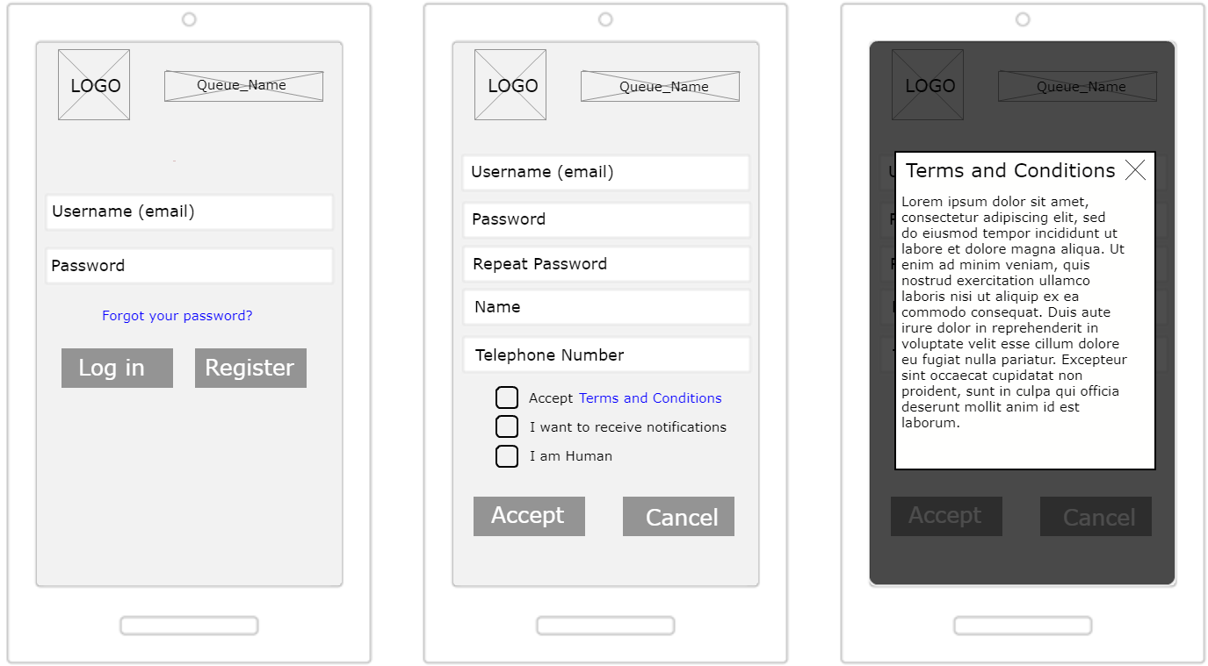
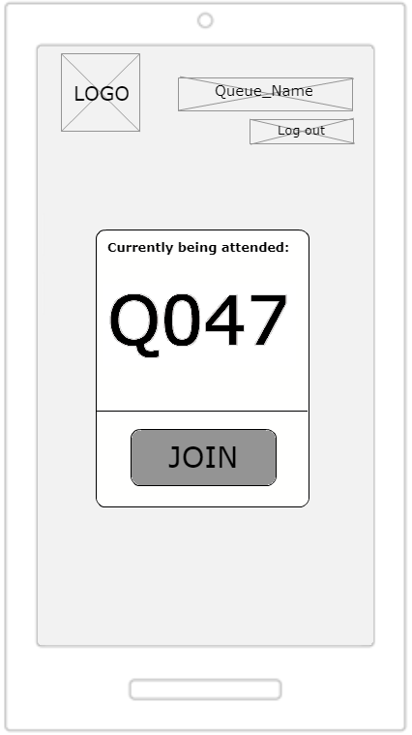
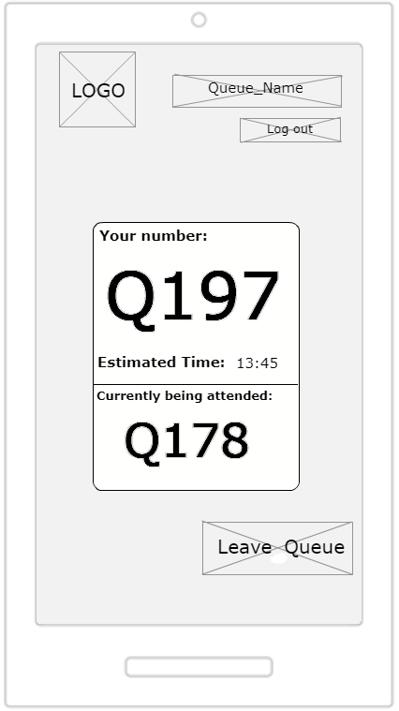
Sketches User Screens
Select login or register
Terms &
Conditions
Register to the queue
Request to join the queue
Show the queue
Select login or registration
Register to the queue
Terms & Conditions
Popup
Request to join the queue
Show the queue

Slide 23
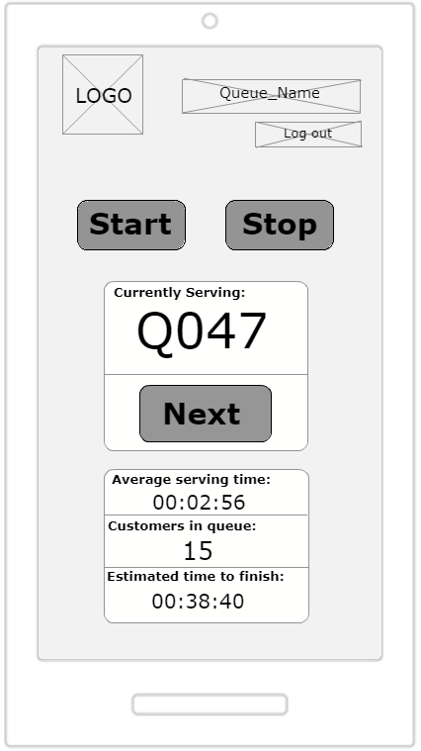
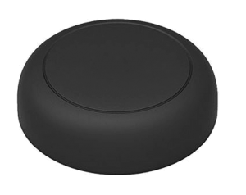
Sketches Owner Show/Serve Sample
Operate the queue
Serve Queue
(physical button)

Slide 24
Entity-relationship
Visitor
VisitorTicket
id
modificationCounter
username (email)
name
password
phoneNumber
acceptedCommercial
acceptedTerms
userType
id
modificationCounter
ticketNumber
creationTime
startTime
endTime
1
0..1
0..n
1..n
DailyQueue
id
modificationCounter
name
logo
currentNumber
attentionTime
minAttentionTime
active
1
1

Slide 25
Conclusions
We will follow an Agile methodology for the development of the solution in order to reduce the time of each delivery and assure the business needs.
This document covers the necessary aspects that the system must fulfill.
In the following analysis phase, we will detail all solution aspects.

Slide 26
Thanks for your attention

